Slide 1
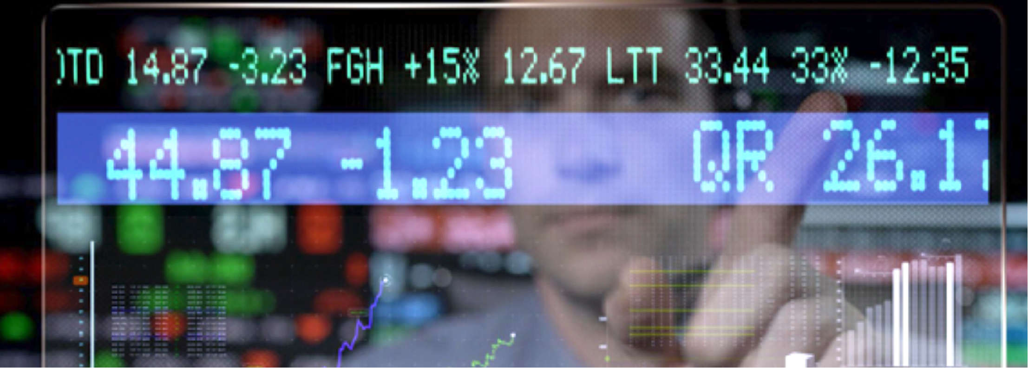
Stock Market Game
HMJ Graphed
Amitav Panda, Houssam Moustafa, Eric Han, Jose Gavilanes, Damian Richardson

Slide 2
Ever think about investing in the stock market?
Have you ever thought about investing in the stock market?
Did you shy away because of all the horror stories?
Did you actually make money?

Slide 3
Problems with Stock Market Games
Apps like Kapitall, and Bux all claim to be able to teach you about investing in the stock market by going up against others in a short-term competition.
Notes:
http://time.com/money/3714370/the-problem-with-stock-market-games-they-arent-boring-enough/

Slide 4
What’s The Solution
HMJ Graphed is a highly sophisticated game built by a team of professionals with years of industry experience
We give you a fast paced yet controlled environment
It’s entirely FREE

Slide 5
What Does HMJ Graphed Do?
We teach you to learn and look for patterns
The fast pace can teach you how to day trade
We allow you to play at any time

Slide 6

How We Did it
Models, Registration, and Login – Amitav
API Routes and game logic – Houssam
Front End – Eric
Technologies used – NODE, Express, Mysql, Sequelize ORM, Materialize

Slide 7
What We Learned
FULL Stack application development
        Limitations of free tier of JawsDB in Heroku
Collaborative work using Github and Zoom
Using new framework Materialize for styling
Should not use UI objects as storage
      Extremely slow upload of data
        Planned to load 20 years worth of stock data for 20 company (100,880) rows
        Load 7 years of data for 16 companies (27,760) rows

Slide 8
Next Phase
Use Visualization Library D3.JS to show time series progression of stock data
Could leverage a more powerful DB server (not a free tier) to speed up data load activity
Company logos to appear on stocks we purchase with an image card

